Slide 1
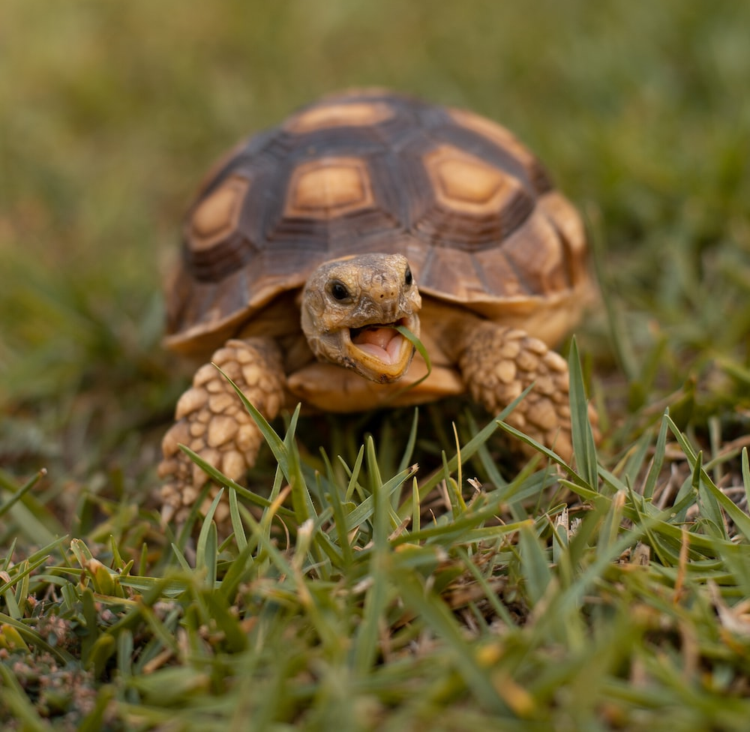
Tortoise Daily Routine
Ordinary day that leads to extraordinary life.
gregdyche@creighton.edu

Slide 2
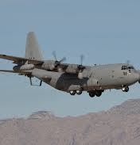
Helllo
Who am I?
  Husband, Father, Professor, Friend
https://www.linkedin.com/in/gregdyche
What’s my job?
Looking out the window

Slide 3
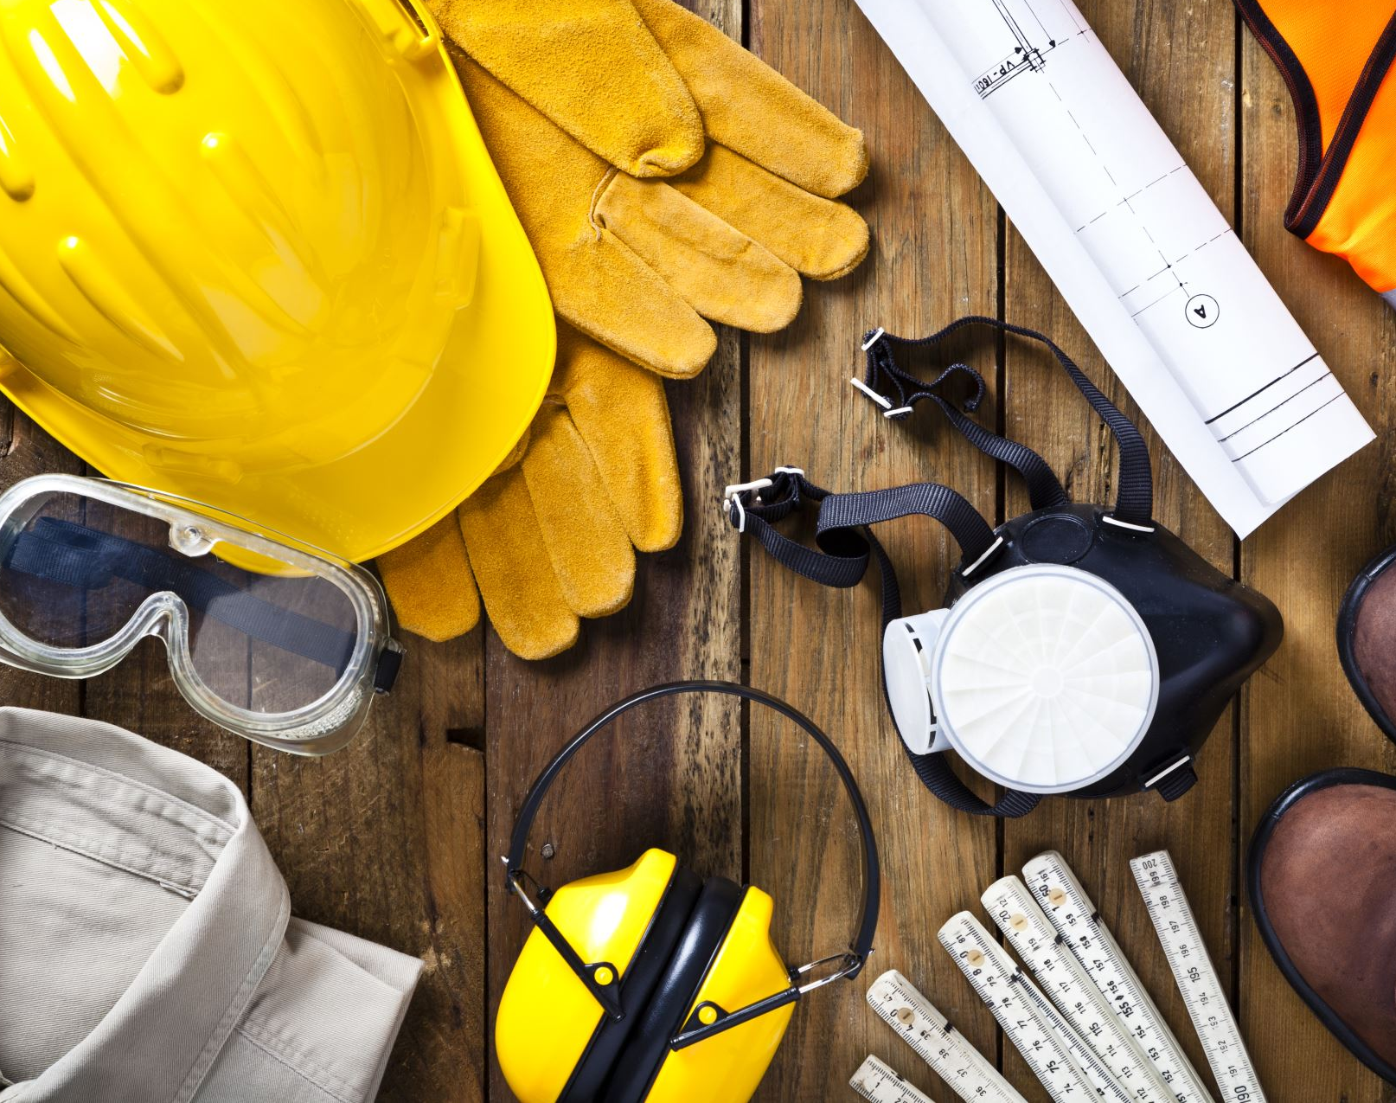
Today’s Promise
Work with me for the next 50 min, and you’ll walk away with a plan.
A planned routine that leads to success.
You’ll have the tools to adjust and get back on course.

Slide 4
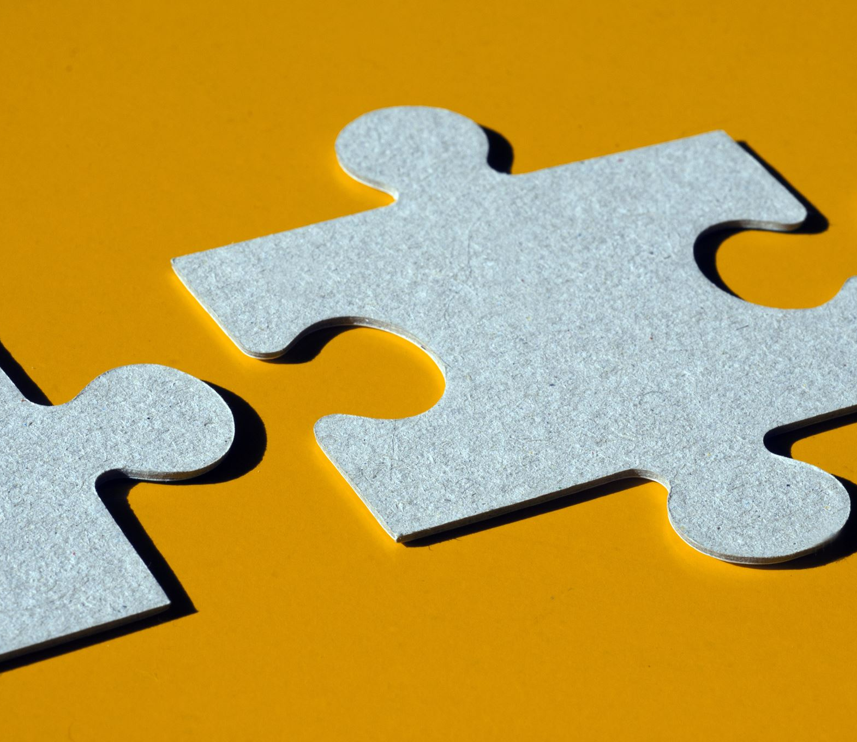
Career is off to a great start

Slide 5
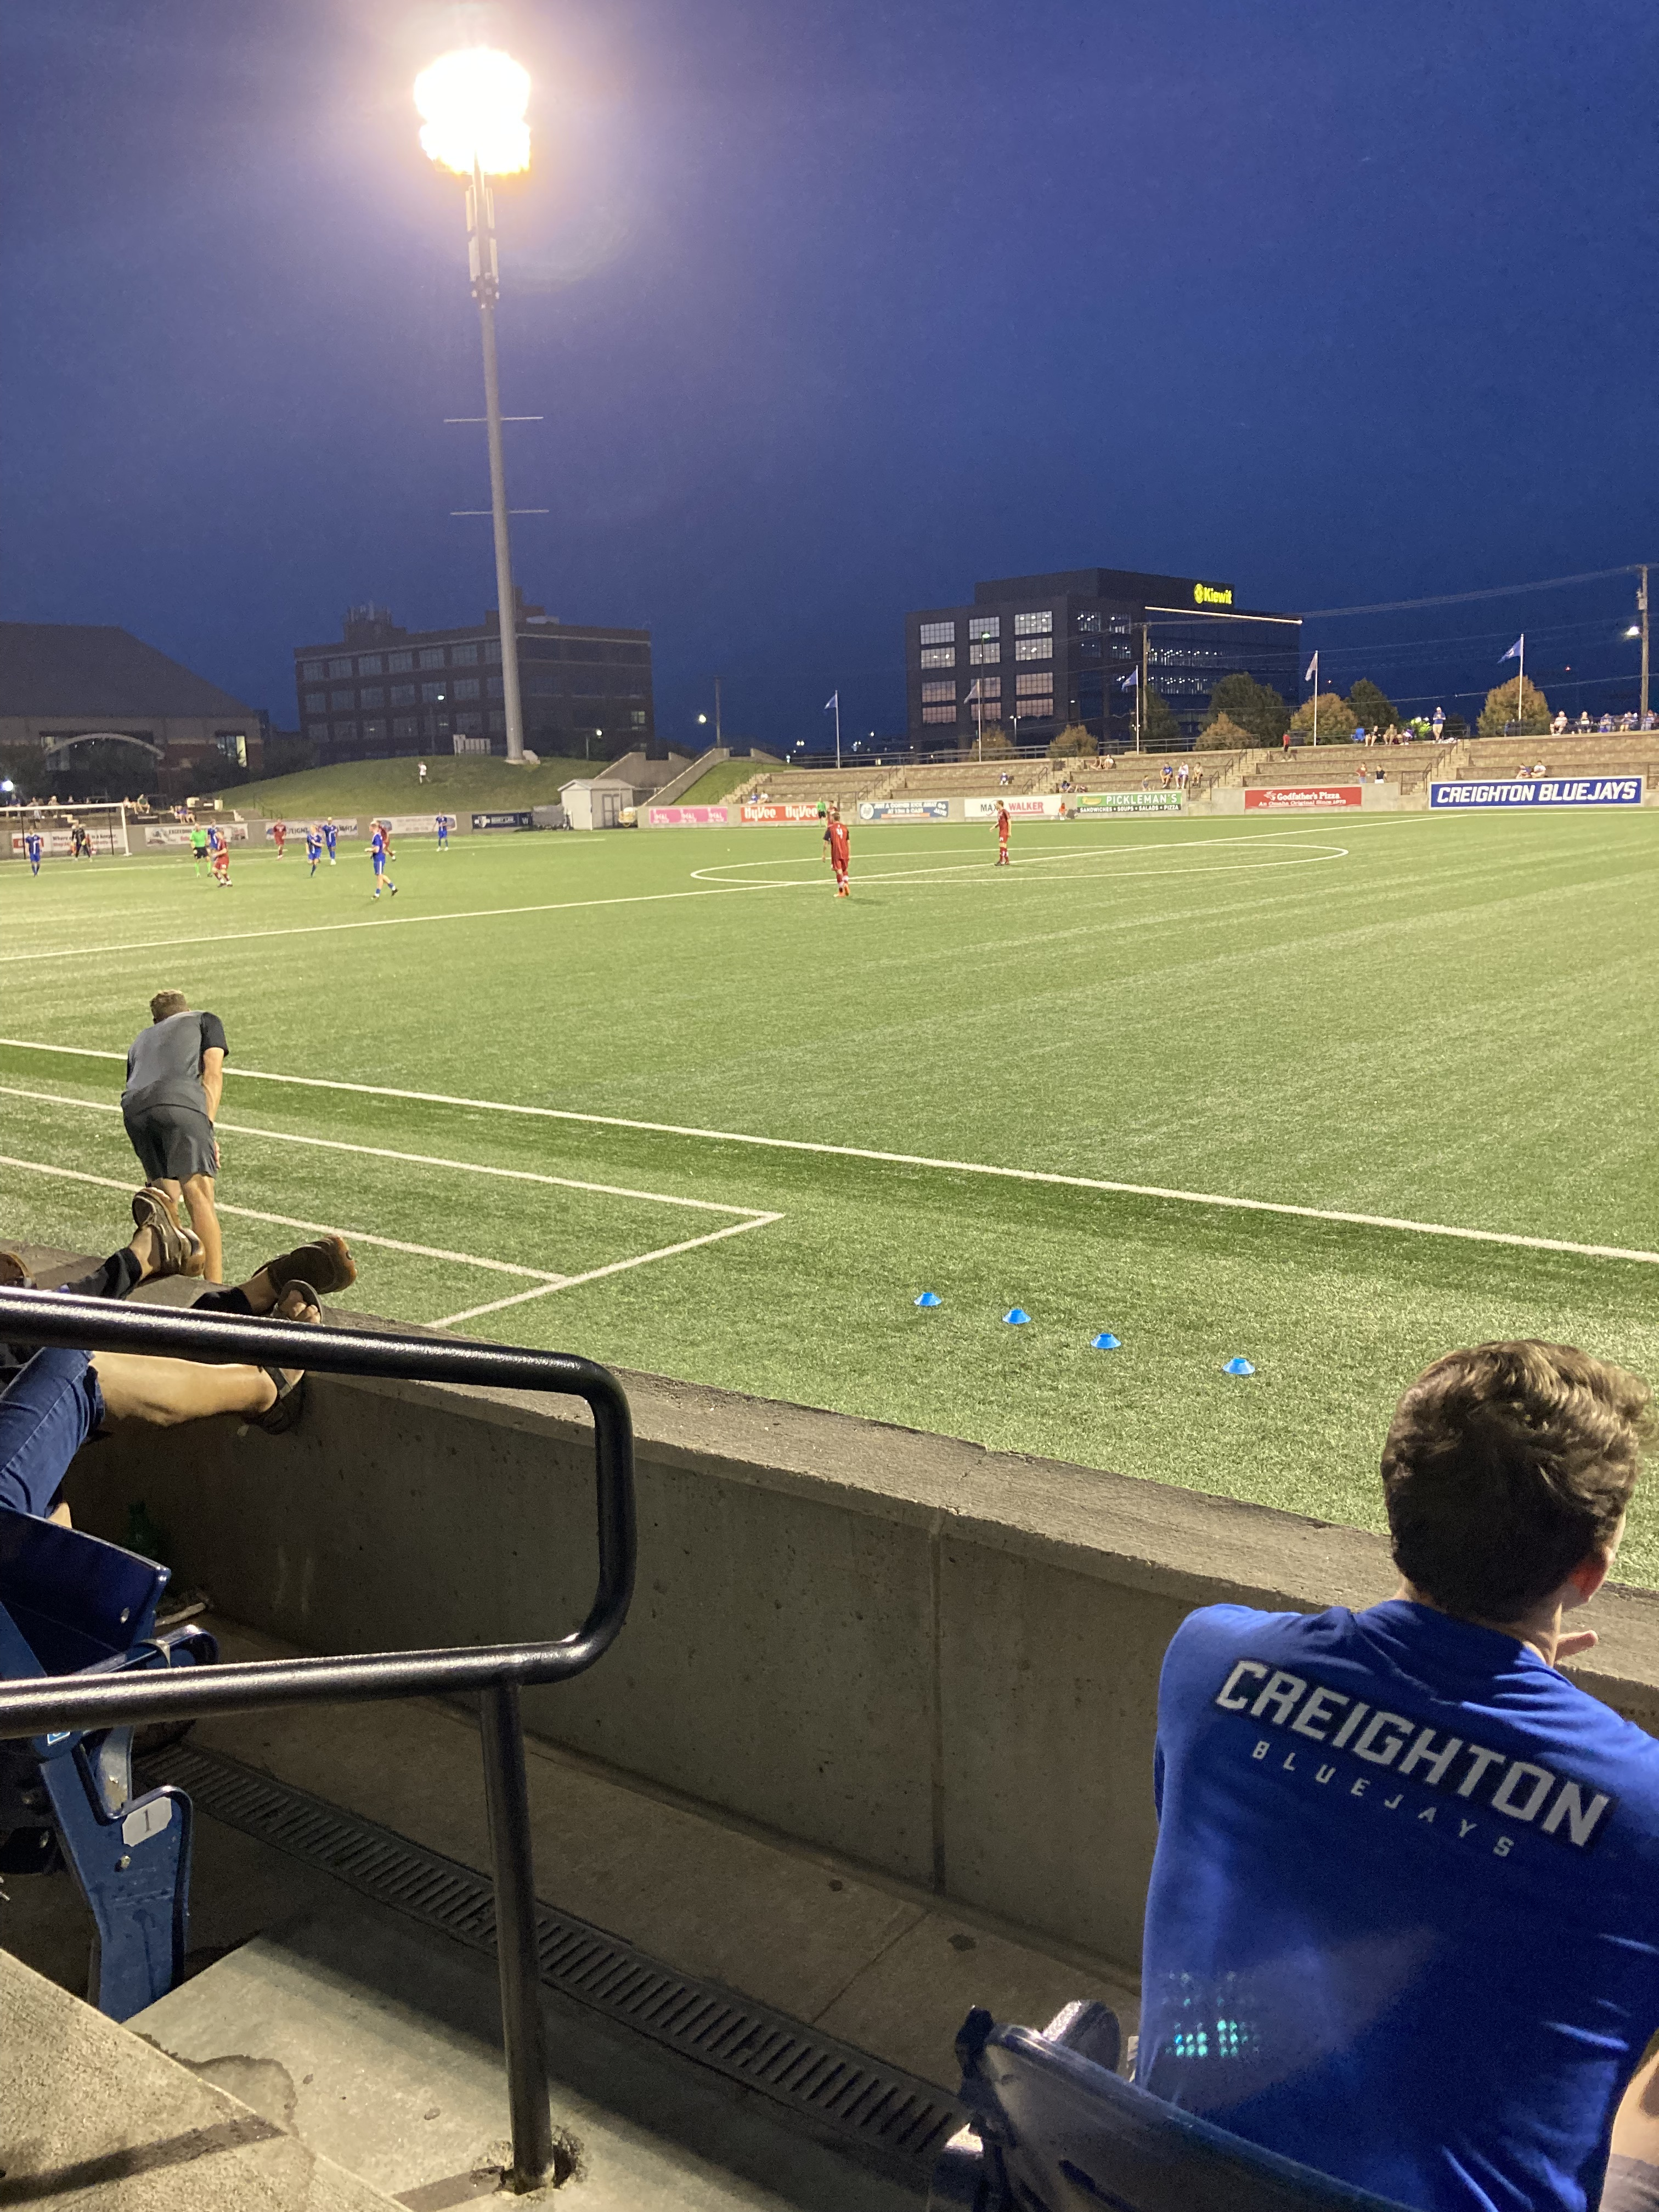
Starting to wonder
How to do more isn’t obvious.
Worked last 3 weekends in a row.
Missing a 3-day trip with friends.
So
…this is what burned-out starts to feel like.
Human Being or Human Doing?

Slide 6
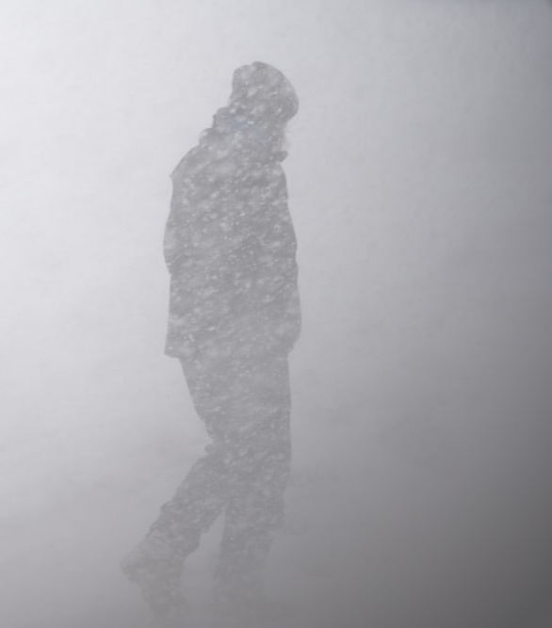
You don’t have the right to be a lump on a log
I remember the day when the lights turned off and wind was blowing snow.
”What you can be. You must be.” Abraham Maslow on Self-Actualization
Where to start? Why is it so hard?
  Foundational needs first, Maslow
Actual
Esteem
Love/Relationships
Safety
Physiological
Notes:
you need to address the underlying needs before reaching higher. Get help before you need it, see a therapist, hire a coach, do what it takes

Slide 7
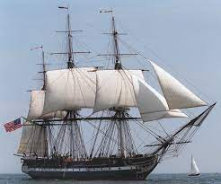
Where to go now?
Drucker’s 5 questions:
What do you want to be remembered for?
Who do you want to be remembered by?
What do they find important, not you?
How are you going to measure their value?
What’s your plan?
* ask every 6 months
Notes:
story of ship captain: the captain knows where the ship is headed at all time.

Slide 8
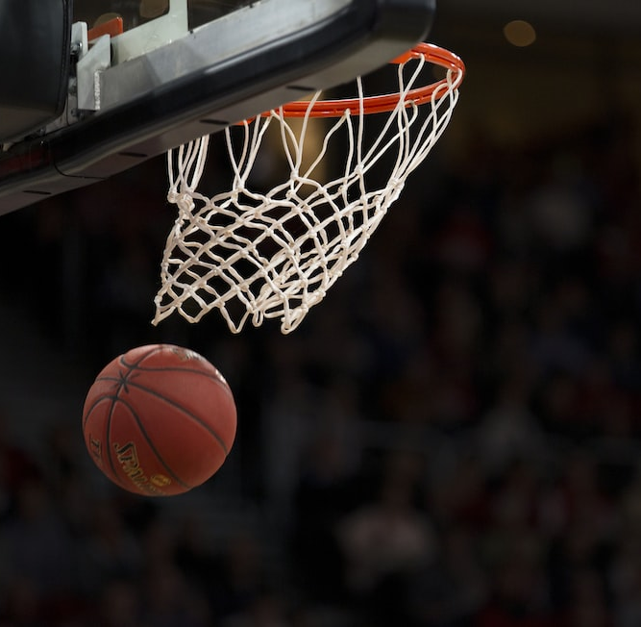
Get excited. Your player has a hot hand.
Nope. Only temporary success. No such thing has a hot hand in basketball.
What matters is the routine.
It’s not the will to win that matters. Everyone has that will to win. It’s the will to practice.
Let’s use this to our advantage and build a daily routine that wins.
Notes:
Charles’ half-court shot for $50

Slide 9
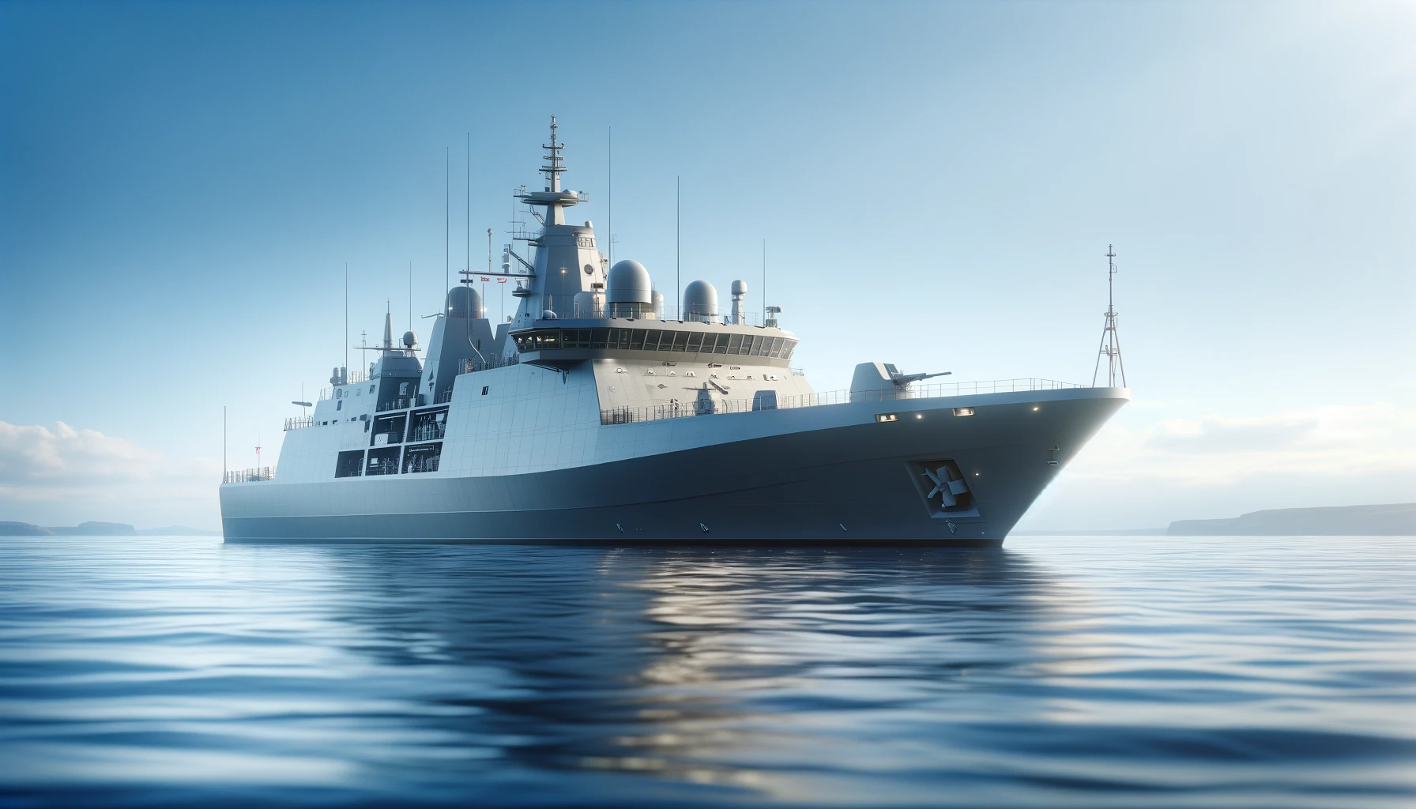
Goals, Destinations, Standards, and Habits.

Slide 10

3 Daily Zones
7:00 AM – 1:00 PM
A: highest energy, best time to approach puzzles, be brave
2:00 PM – 8:00 PM
B: more open minded, best time for mysteries, creativity rules
9pm to morning
C: rest, relax, recharge, sleep

Slide 11
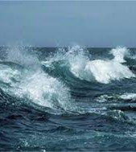
There’s not enough of you to go around.
Who gets the best of you?
Your “A” game.
Who gets the most of you?
During the “A” zone.
The secret scorecard is
“How do we treat others?”.
Notes:
How much of you is left to build back stronger to help others tomorrow? Taught us in survival school the importance of staying healthy, so we can fight again tomorrow. What are you fighting for?

Slide 12
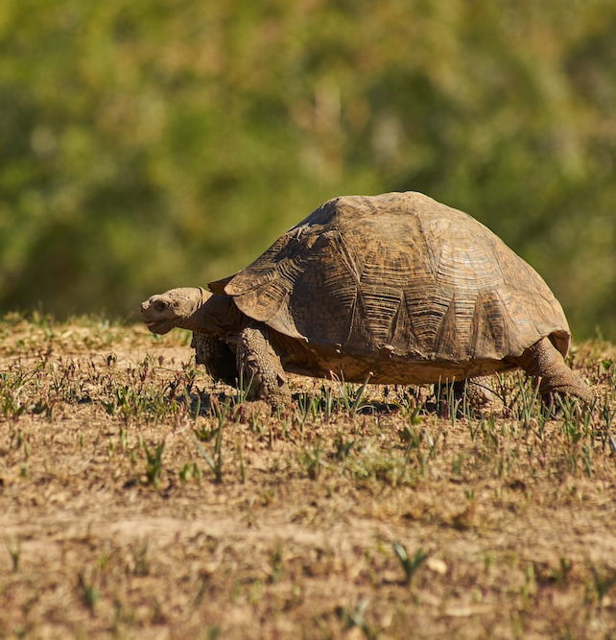
What’s in your A zone; anything for you?
Early sunshine, exercise
Planned eating
Journal, gratitude
Meditate
Time with loved ones
Or are you too worried about working you don't have time for others?
Remember, the tortoise had a plan for race day.
Notes:
You don’t show up on game-day and say, “Gee, fellows, what do you think we need to do today?” No one climbed Mount Everest by showing up at the bottom, looking up, and saying let’s try.

Slide 13
Some is better than none. Now is better than later.
A zone : 7am to 1pm for starters, adjust later.
  decent breakfast.
  sunlight if possible.
  gratitude journal.
  prayer, meditate.
Reflection
B zone: 2pm to 7pm, adjust as you learn
  open meetings.
  what-if journaling.
  block time for family if needed
Best work to do:
  New Ideas
  Study
  Move the most important project forward
    Index card
      first task
      second task
      third task

Slide 14
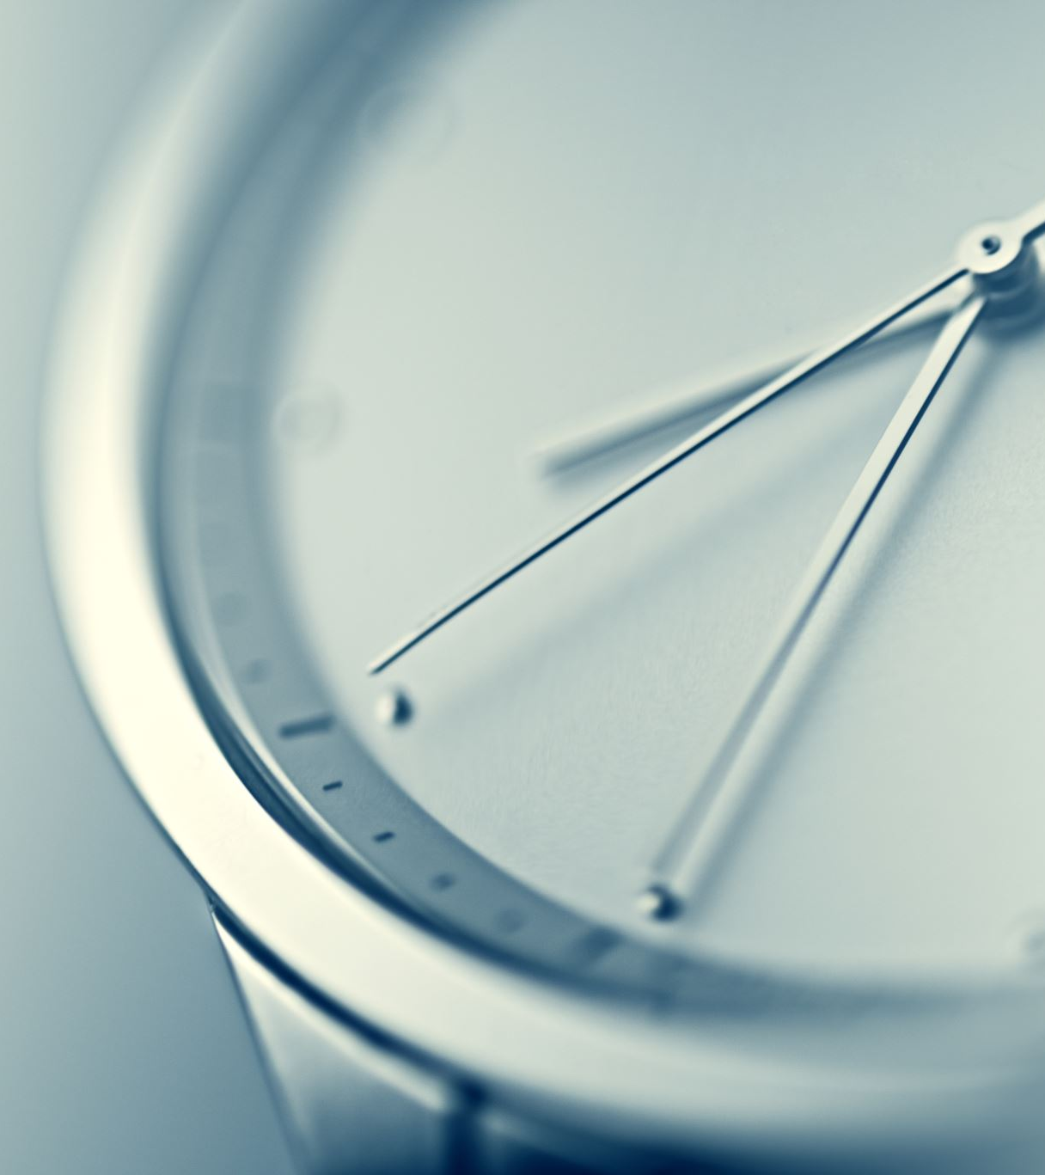
Build a test Turtle-Day for summer.
What’s a typical, good day going to look like for you?
A: start time
  primary rocks
B: start time
  primaries
C: rest process
Sleep goal
Write out a test schedule, so you have something to edit.

Slide 15

Best time to plant a shade tree?
20 years ago, next best time? Today.
Don’t allow the shame of delay to stall your start.
Write out an ordinary, everyday routine.
  You get the best of you, so you can be strong enough to help others.
  Pay yourself first.
What are you going to NOT-do?

Slide 16
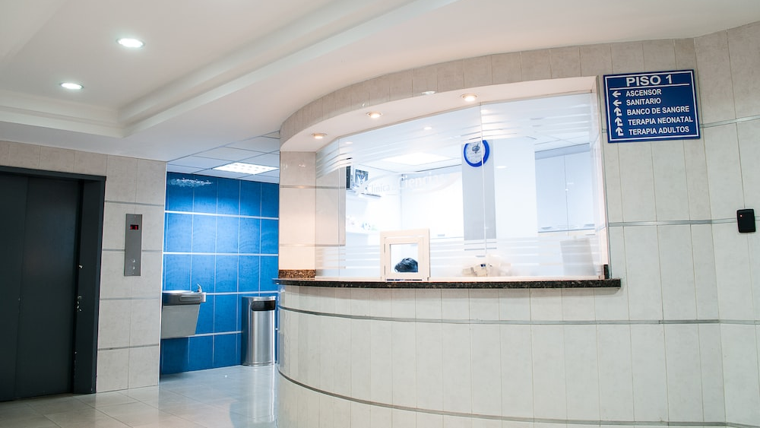
Why doesn’t it work?
This isn’t new advice. Age old, simple advice is the answer.
So why don’t you follow it?
Did you hear the alarm?
Notes:
Hospital virus story: we waited and it go much, much worse. We didn’t know when to sound the alarm.

Slide 17
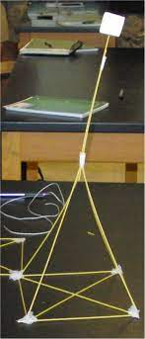
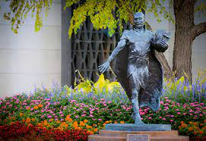
Reflection:
Early warning system
Superpower.
The Examen
  noon – check in
    On-track
    Having fun (getting energy from your work)

Slide 18
Call your shots – feedback game.
Tell me what you’ve done, not what you are going to do.
Write down your intentions for the week
Review at the end of the week. Did you accomplish your intentions?
  Why not?
  It’s not a critique. it’s a conversation.
  Honest dialogue with the mirror (or your coach if you are fortunate)
  What’s in the way?
    Won’t do?
    Can’t do?

Slide 19
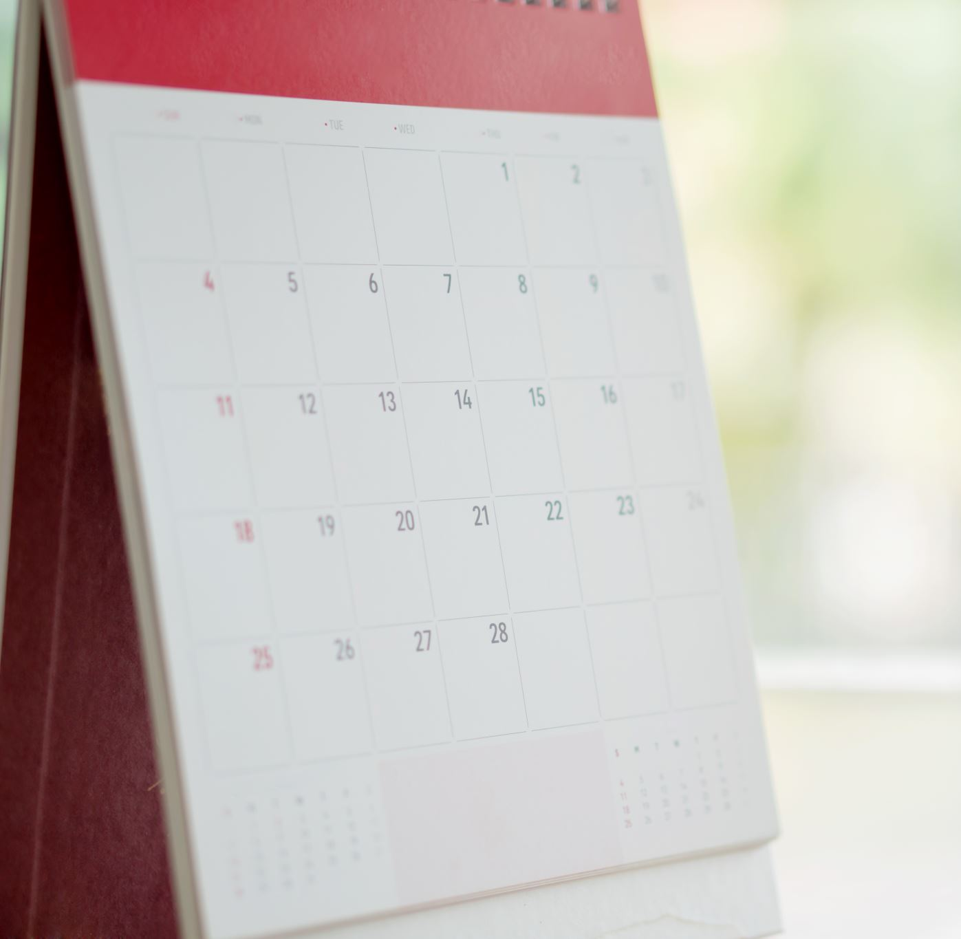
Daily A zone ideas
Spend time on what’s important to you.
  Side project?
  Writing?
  Find the best time of day and pay yourself first.
What’s the important thing for you?
  Prepare?
  Act?
Paperwork that requires more of an analytical mind?

Slide 20
Daily A zone traps to avoid
  Open OneNote first – “start here” document
    reminders for good routines
  Set Outlook to open to calendar not email
  If you can delete the email, trash it.
  If you can respond in less than 2 min, just do it.
  If it takes more thought, schedule it.
    Not to-do list – that’s a wish list.
    When? Schedule work on your calendar.
  Want less email? Send less email.
    call, visit, text, message via social – anything but email ☺
Important/ Urgent | Urgent | Not-urgent
Important | Q1 | Q2
Not-Important | Q3 | Q4
Notes:
modified form David Allen’s GTD

Slide 21
Daily A zone dangers
Operate vs Lead
Sit down to work and don’t look up till lunch.
Lead your day or get pulled along the current of the urgent.
Work on tomorrow. What can you prep today to make tomorrow a better day?
Notes:
operate vs lead your life like operating a car with no destination vs going somewhere

Slide 22

B Zone ideas
More creative endeavors.
Being a little tired relaxes your guard, and you are more open to new ideas (like now ☺ )
Careful about shopping during this time. you are more likely to impulse buy, especially online.
Brainstorm
Write
Follow-up friends and family

Slide 23

Build an ordinary Tuesday
A typical Tuesday that keeps you on course headed toward your destination.
A typical Tuesday that becomes you average, the routine you return to when you get tired. Return to the mean.
You got a plan started today. Adjust it. Make it your own.
Leave room for fun. Do you it your way.

Slide 24
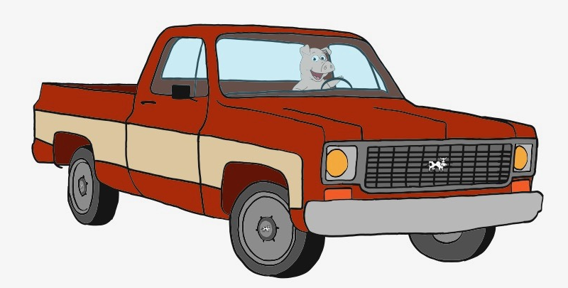
If you walk away with one slide…
What do you want to be remember for? Where are you headed?
Call your shots and review results each week.
Guard your best time and invest in yourself first.
You are being scored on how you treat others.
”I can think of nothing better than to eat, drink, and enjoy your toil” Ecc 2:24
Greg Dyche
Notes:
be a truck-drivin pig

